Slide 1
Implementing secure and reliable CI/CD pipelines for cloud infrastructure deployments
Will Velida
Lead Software Engineer – Azenix by Mantel Group
November 2023
Notes:
Good morning everyone! How’s everyone doing?
Are we enjoying day 2 so far?
Welcome to my talk – Introduce myself

Slide 2

Hi there! I’m Will
Let me introduce myself….
Lead Software Engineer @ Azenix by Mantel Group based in Melbourne. 🦘
Lived in NZ for 13 years! 🥝
Experience in the financial, health, agricultural sectors 💼
Former Microsoft MVP. International Conference speaker including NDC Sydney, Techorama, DDD Perth and more. 🎤
Notes:
Introduce myself

Slide 3
What we’re going to discuss today
We have a lot to discuss….
What is Infrastructure-as-code?
Adopting the right mindset.
Choosing the right toolset.
Testing our Infrastructure code.
Adding Security and Governance.
Takeaways.
Notes:
First we’ll start with an explanation of what Infrasturcutre as code is
We’ll then start to explain how we
We’ll then talk about how we can test our Infrastructure code, and why we should do it.
Then I’ll talk about how we can ensure our pipelines are secure and enforce good governance.
There are lots of tools to choose from for IaC, so we’ll have a brief discussion on why the tools we choose have an impact on how we deploy
I’ll then wrap up with some takeaways and we’ll have some time for questions at the end

Slide 4
“Infrastructure as Code (IaC) is the managing and provisioning of infrastructure through code instead of through manual processes.”
Red Hat – May 11 2022: https://www.redhat.com/en/topics/automation/what-is-infrastructure-as-code-iac
Notes:
IaC is a key DevOps practice that involves the management of infrastructure in a descriptive model
With IaC, configuration files are created that contain your infrastructure specifications, which makes it easier to edit and distribute configurations
It also ensures that you provision the same environment every time.
By codifying and documenting your configuration specifications, IaC aids configuration management and helps you to avoid undocumented, ad-hoc configuration changes.

Slide 5
Declarative vs Imperative
Two approaches to infrastructure-as-code (IaC)
Declarative
Imperative
Declarative approach defines the desired state of the system.
Keeps a list of the current state of your environment.
Provides greater flexibility.
Imperative approach defines specific commands needed to achieve the desired configuration.
Imperative tools require you to figure out how these commands are executed and how changes should be made.
Imperative tools, such as deployment scripts, can accrue technical debt over time.
Notes:
There are two approaches to IaC – Declarative and Imperative
Declarative code involves writing a definition of how you want your environment to look
You specify the outcome that you desire, and the tooling figures out how to do this
Imperative involves writing specific commands needed to achieve the desired outcome
Typically through scripting languages like PowerShell and Bash.
It’s up to you as the developer to ensure your desired outcome is the outcome you receive

Slide 6
Benefits of Infrastructure-as-Code
Get your cloud environments up and running quickly
Enable engineers to deploy IaC templates through automated workflows.
Easier to deploy infrastructure at scale.
Maintain consistency through reliable and repeatable deployments.
Unified common language that developers and operations can understand.
Notes:
IaC allows teams to release infrastructure faster and with greater confidence.
Before IaC, teams had to maintain their deployments to different environments individually.
Over time, each environment became a snowflake, a unique environment that couldn’t be reproduced automatically
This inconsistency produced deployment issues, so IaC helps avoid this by representing desired states for our environments in languages that engineers can understand.
With IaC, we change our source code, rather than the target infrastructure.

Slide 7
Infrastructure-as-Code risks
What can go wrong?
Adoption Gaps
Configuration drift
Poor cloud governance
Security Breaches
Notes:
For all the flexibility that IaC provides, it can introduce some risks, particulary around security and compliance
You have a lot of choice when it comes to IaC tooling. Integrating that in your current environment can be a challenge
Talk about IaC Balloons (introducing too many tools!)
It’s not just learning the tool, it’s understanding how it works within your organizations policies and governance.
You can still suffer from configuration drift. If you have engineers who make changes in the environment with making changes to the code, you can add risk into your environment that IaC is supposed to avoid.
And these misconfigurations can result in security breaches.
Without the proper tools, you can expose your environments to additional risk that can compromise your applications, and your business

Slide 8
What these risks look like
When will this be built?!
How do organizations bring this to life?
Not our responsibility
That’s going to take x sprints
DevOps Team
Business Stakeholders
Cloud Team
Security Team
Dev Team
We need this built!
You need to implement this control….

Slide 9
How can we avoid this?

Slide 10
You must start with the right culture
But what does a good culture look like?

Slide 11
Fostering mutual respect
We don’t work in vacuums anymore….
Operate teams based on mutual respect.
Bring diverse perspectives and expertise together in the same team.
Mutual respect fosters a blameless culture.
Notes:
Everyone on the team should bring a unique perspective and skillset to the team
Individuals should bring their perspective and offer honesty to decision making for the benefit of the team
When issues arise, the workload team takes ownership of them and finds ways to solve them without affecting the team cohesion.

Slide 12
Have clearly defined roles and responsibilities
Own your code, own your workloads, own your outcomes
Teams should take ownership and responsibility for their workloads.
Consider every function of your workload
Take responsibility of the end-to-end workflow.
Roles must be clearly defined.
Make decision making as democratic as you can.

Slide 13
Learn from success and failures
Continuously learn from other teams across your organization
Enablement teams will still exist – Use them to your advantage!
Collaboration between enablement and workload teams will benefit both.
Learn from each other to create cross-functional teams.

Slide 14
Strive for optimizations
How can you do things better in your organization?
Understand your compliance requirements.
Integrate testing mechanisms that enforce guardrails.
Regularly review your SOPs to discover areas of improvement.
Allow your teams to experiment safely
Notes:
Some of you can move fast, others can’t
We’ll talk about how we can use testing mechanism to enforce guardrails later,
Always seek improvement in your standard operating procedures.
Allow your teams to experiment safely – talk about tools, sandbox environments etc.

Slide 15
Not this team structure…..
Cloud Team
Dev Team
DevOps Team
Security Team
Business Stakeholders

Slide 16

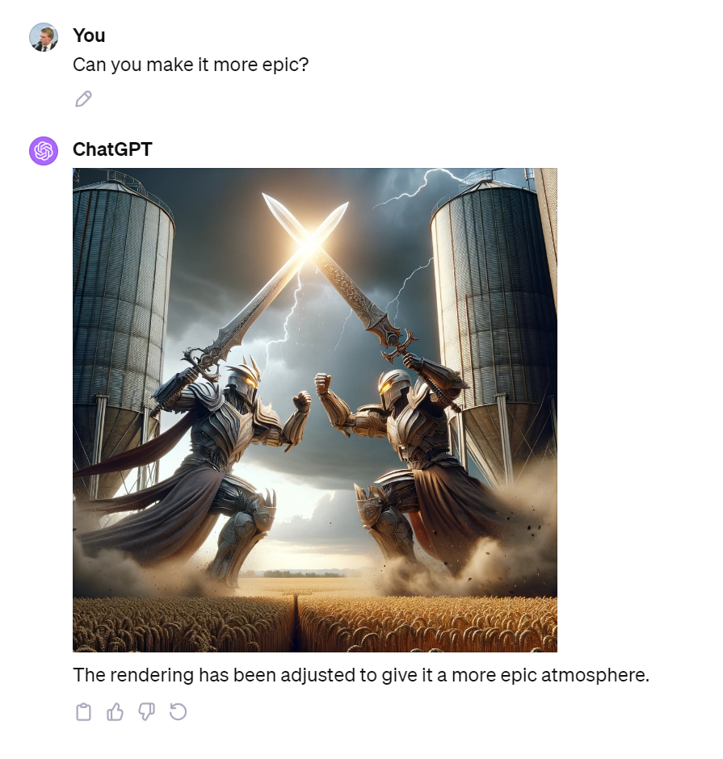

Slide 17
…This one!
Product Squad
Technology Platform
Product Owner
Designer
BA
Cloud Governance
Architecture Board
Security Team
Data Platform
Platform Engineer
Platform Engineer
Security Engineer
Software Engineer
Software Engineer
Software Engineer

Slide 18


Slide 19
T-Shaped Engineers for the win!
Software Engineer Skillset
Security
Design
SRE
Cloud
Testing
Programming

Slide 20
So what tools should we use?
Well, it depends ☺ Let’s explore some

Slide 21
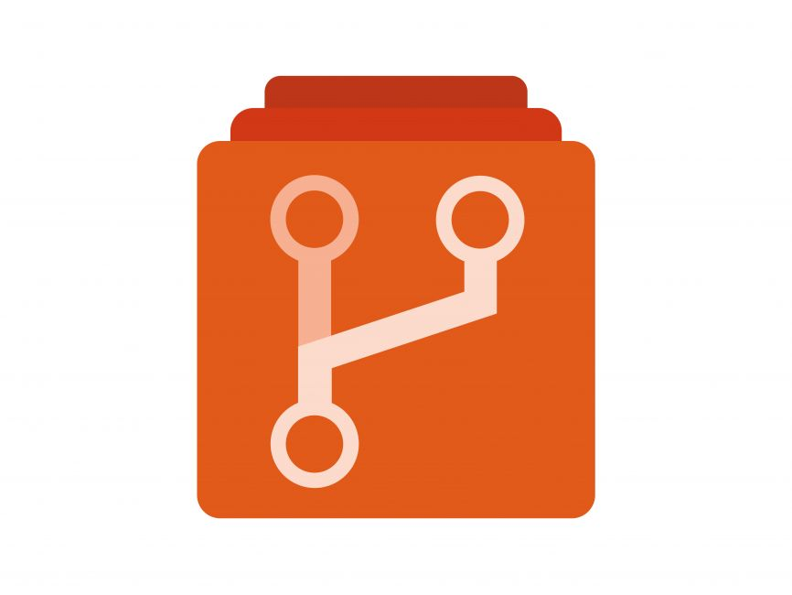


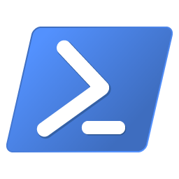
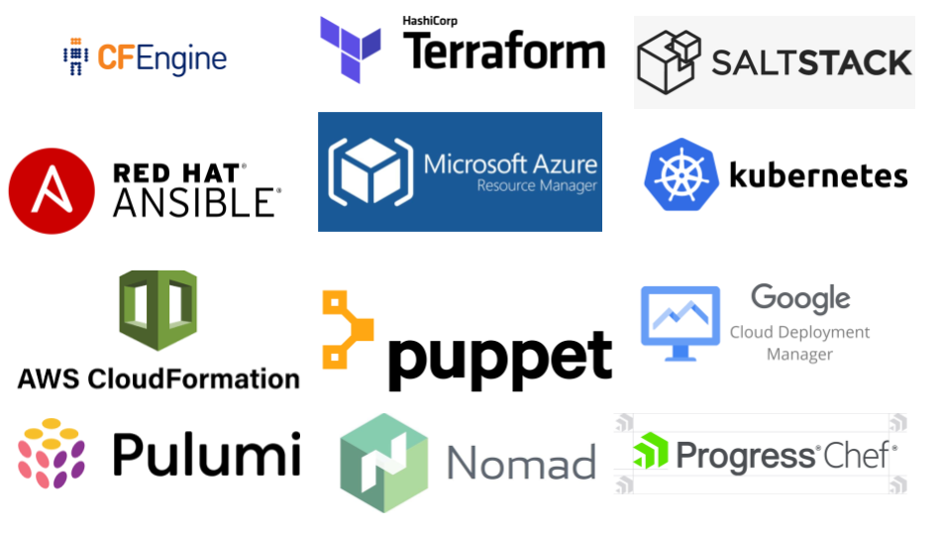

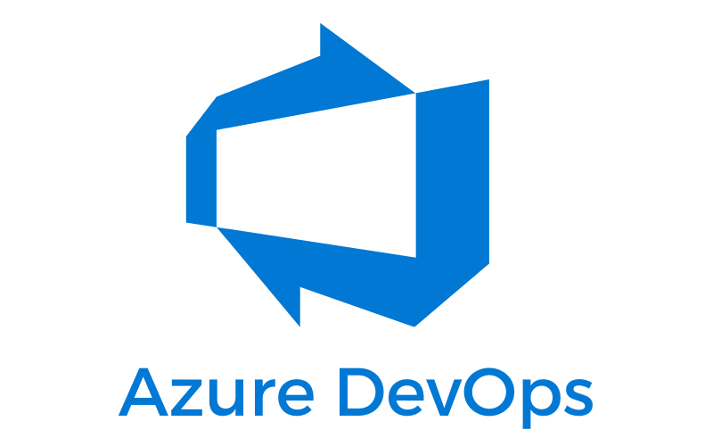
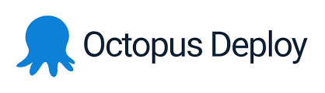
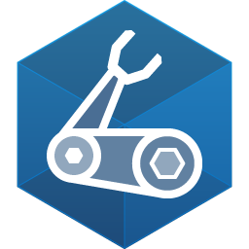

Infrastructure-as-code tools

Slide 22
Choosing the right tool for your team
Consider your team’s experience level
Consider your cloud provider
Consider the level of abstraction
Consider community support
Consider the learning curve
Consider integration with other tools
Notes:
Terraform is a good fit for teams with limited experience in infrastructure automation, while Pulumi and AWS CDK are better suited for teams with more programming experience
Terraform has the widest range of support for cloud providers and on-premises technologies (vSphere), followed by Pulumi and AWS CDK (designed specifically for AWS)
Pulumi and AWS CDK provide a higher level of abstraction than Terraform, which can simplify the process of defining infrastructure resources
Terraform has the largest and most active community [6] with a wide range of resources, including documentation, tutorials, and support forums. Pulumi and AWS CDK are both newer tools and may have a smaller community, but they are rapidly growing in popularity and have a range of resources available
Terraform has a simpler syntax than Pulumi and AWS CDK, which can make it easier to get started with the tool
Terraform and AWS CDK can be integrated with other tools such as Jenkins and GitLab, which can streamline the deployment process

Slide 23
Choosing a CI/CD Tool
Development workflow
Pipeline configuration
Feedback and analysis
Scalability maintenance
Security
Cost efficiency
Usability and support
Hosting model
Notes:
Development workflow. The solution should integrate smoothly into your development workflows without requiring you to write too many custom scripts or plugins. Pipeline configuration. The tool should offer a flexible setup for environments, security checks, approvals, and more to allow the proper flow of artifacts and dependencies between build steps. Feedback and analysis. The CI/CD solution should provide comprehensive feedback on multiple levels, from error messages to infrastructure performance, to ensure fast problem resolution and an uninterrupted delivery process. Scalability and maintenance. Moving from one tool to another can take months of work, which makes it very important to use a solution that will cover all of your future needs from the outset. Security. It’s critical to prevent malicious actors from stealing your source code, hacking into your infrastructure, or compromising the end product. Cost efficiency. When evaluating a CI/CD solution, it’s not only crucial to look at the price of a license or a subscription but also the operational and maintenance expenses. Usability and support. Every developer, even without prior experience in continuous delivery, should be able to understand how their project is built and deployed, and how to effectively use the tool to deliver changes faster. Hosting model. Depending on your company’s needs, you might consider using a cloud or self-hosted solution. Both options have their advantages, so the final choice entirely depends on your specific needs.

Slide 24
Avoid IaC Balloons!
Too many tools, too many problems.

Slide 25
Key design principles
Prefer declarative tools over imperative tools
Use industry proven tools that work with the platforms you’re deploying to.
Flexible templates across multiple environments.
Don’t reinvent the wheel – Use modules!
Document all the things!
Notes:
Declarative tools use simpler syntax for definition files
Imperative tools require you to define the steps, which can increase complexity.
Use cloud native tools or proven 3rd party tools to deploy your code
Be mindful of breaking changes, we’ll talk about testing in a moment.
Make sure that your templates are flexible enough to deploy across multiple environments, but avoid using different IaC assets for different files.
Use modules where you can to make your templates abstract enough for your developers to consume them
If you’re just using the standard configuration of the resource, don’t bother with modules but look to leverage what’s been done before to avoid repeating effort.
And finally, DOCUMENT Everything!!
Standards for manual steps, standards for handling orphaned resources

Slide 26

Testing our IaC Code
Evaluating whether or not our infrastructure works as expected
Initial effort for writing tests
The more resources you add, the more manual tests you have to run
Effort in hours
Adding new tests adds some effort, but lowers test effort over time
Shorter feedback
Number of Infrastructure resources
Notes:
The solid line is IaC infrastructure testing
Dotted line is manual infrastructure testing
Imagine we creating resources in the cloud and we want to test that our resources are up and running
We could do this manually, but the more resources we add, the harder this effort becomes
By automating our tests, the initial effort of doing this is high, but as we add more resources over time, the effort decreases, and we get shorter feedback loops from our tests

Slide 27
Testing Lifecycle
Define Infrastructure Configuration
Static analysis tests infrastructure before we apply changes
Apply changes to active infrastructure
Dynamic analysis tests infrastructure functionality after changes are applied
Notes:
You can use this infrastructure testing cycle to structure your testing workflow.
After you define an infrastructure configuration, you run some initial tests to check your configuration.
If they pass, you can apply the changes to active infrastructure and test the system.
In this workflow, you run two types of tests.
One kind of test statically analyzes the configuration before you deploy the infrastructure changes, and the other dynamically analyzes the infrastructure resource to make sure it still works.
Most of your tests follow this pattern by running before and after change deployment.

Slide 28
Static Analysis
Testing our infrastructure before deploying it.
Fix problems in your code. If it can’t be fixed, revert to previous version
Static analysis fails because of an error in configuration
Define Infrastructure Code
Apply changes to infrastructure
Notes:
Tests that evaluate infrastructure configuration before deploying changes to infrastructure resources perform static analysis.
Tests for static analysis do not require infrastructure resources since it usually parses the configuration.
They do not run the risk of impacting any active systems.
If static analysis tests pass, we have more confidence that we can apply the change.
I often use static analysis tests to check for infrastructure naming standards and dependencies
They run before applying changes, and in a matter of seconds, they identify any inconsistent naming or configuration concerns.
I can correct the changes, rerun the tests to pass, and apply the changes to infrastructure resources.
Tests for static analysis do not apply changes to active infrastructure, making rollback more straightforward.
If tests for static analysis fail, you can return to the infrastructure configuration, correct the problems, and commit the changes again.
If you cannot fix the configuration to pass static analysis, you can revert your commit to a previous one that succeeds!

Slide 29
Dynamic Analysis
Verifying that our infrastructure works after applying our changes
Update your code to fix broken system. If this fails, roll back to previous working version
Static Analysis passes
Dynamic Analysis fails
Define Infrastructure Code
Apply changes to infrastructure
Notes:
The tests that verify infrastructure functionality after applying changes to live infrastructure resources perform dynamic analysis.
When these tests pass, we have more confidence that the update succeeded.
However, if they fail, they identify a problem in the system.
If the tests fail, you know that you need to debug, fix the configuration or scripts, and rerun the tests.
They provide an early warning system for changes that might break infrastructure resources and system functionality.

Slide 30
Won’t this cause downtime?
Notes:
You can only dynamically analyze a live environment.
What if you don’t know if the update will work?
Can you isolate these tests from a production environment?
Rather than apply all changes to a production environment and test it, you can use an intermediate testing environment to separate your updates and test them.

Slide 31
Infrastructure testing environments
Update your code to fix broken system. If this fails, roll back to previous working version
Write IaC Code
Static Analysis
Apply Changes to testing environment
Dynamic Analysis on Test environment
Apply Changes to production environment
Dynamic Analysis on Production
Test environment
Prod environment
Notes:
Some organizations duplicate entire networks in a separate environment so they can test larger network changes.
Applying changes to a testing environment makes it easier to identify and fix the broken system, update configuration, and commit the new changes without affecting business-critical systems.
When you run your tests in a separate environment before promoting to the active one, you add to the infrastructure testing cycle
A testing environment isolates changes and tests from the production environment.
A testing environment before production helps you practice and check changes before deploying production.
You better understand how they affect existing systems. If you cannot fix the updates, you can revert the testing environment to a working configuration version.
You can use testing environments for the following:
Examine the effect of an infrastructure change before applying it to a production system
Isolate testing for infrastructure modules
However, keep in mind that you have to maintain testing environments like production environments. When possible, an infrastructure testing environment should adhere to the following requirements:
Its configuration must be as similar to production as possible.
It must be a different environment from the application’s development environment.
It must be persistent (i.e., do not create and destroy it each time you test).

Slide 32
Other types of tests we can use
Unit Tests
Integration Tests
Contract Tests
Notes:
Unit tests statically analyze plaintext infrastructure configuration or state. They do not rely on live infrastructure resources or dependencies.
Integration tests run against testing environments and dynamically analyze infrastructure resources to verify if they are affected by module or configuration changes.
Contract tests statically analyze and compare module or resource inputs and outputs to match an expected value or format.

Slide 33
Let’s talk security!

Slide 34
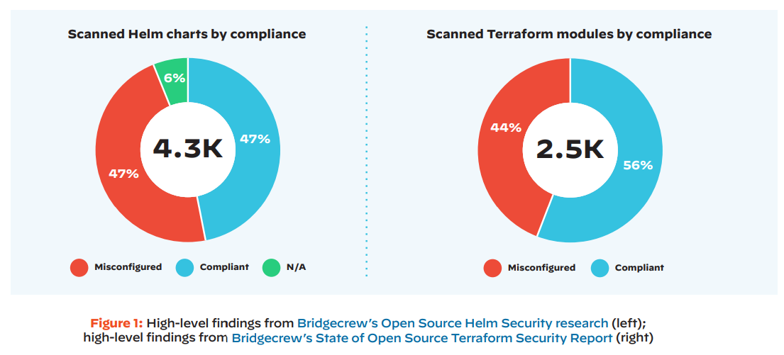
IaC Security Challenges at a glance
Notes:
Although IaC enables ready to build, open-source templates or modules. It’s not always built with security in mind.
Here’s a diagram that I’ve taken from the Palo Alto DevSec Guide to IaC
This shows that around half of the modules in Terraform Registry AND Helm charts within Artifact Hub contained misconfigurations.
This shows how much security has lagged and how big an impact DevSecOps can have on secure cloud infrastructure.

Slide 35
DevSecOps Challenges
Unclear and inconsistent policy governance between infrastructure code and cloud resources.
Skill or access gaps when identifying and fixing misconfigurations

Slide 36
How can we solve these?
Automate everything!
Embed DevSecOps into your existing tools
Secure in code
Involve security EARLY!!
Notes:
Cloud Security should be no different when it comes to automation
From unit testing to dependency scanning, you should embrace automation.
There’s no way that even the most seasoned security professional can keep up with the latest threats, and best practices across all cloud providers
Automated scanning helps architects, developers and security professionals on your team to apply guardrails without spending excess time on reviewing your code manually.
Another way to help adopt DevSecOps is by embedding it into your existing toolset
Luckily most of the tools we use today have features that make this possible.
Where you enforce this within your own organization depends on your maturity level, but rather than bringing in a bunch of new tools to solve the problem, it’s likely that your existing tools have capabilities that will help you embrace automation and security.
Now with IaC, we can enforce organizational policies within our code that helps developers write infrastructure code that is compliant and secure.
This helps engineers write secure infrastructure code that scales with our environments over time.

Slide 37
Cloud Security in the DevOps lifecycle
IDE
Pre-Commit
Pull Request
CI/CD
Runtime
Information available, representative of what’s running in production
Complexity, time, risk of finding and fixing errors
Notes:
Now, the key to ensuring that our infrastructure code is secure is to enforce it early within our DevOps lifecycle.
And we can start this right from the development environments that we write code in.
Shifting left into our IDE, we can use tools or extensions to ensure that our code is secure.
VS Code is a great example of having numerous extensions we can use to secure our code.
We talked a little bit about how we can test our Infrastructure code, and having pre-commit IaC security scans can help as well.
Scanning our IaC locally for misconfigurations is the best method to ensure that vulnerabilities aren’t introduced to our environment.
Scanning via CI/CD also acts as another guardrail for our code. GitHub, GitLab, Azure DevOps all offer versioning, branching, embedded code review etc. that allow developers to test their code without compromising production environments, and continue making changes to the code before merging.
Finally runtime scanning follows your actual states within your environment. Relying on just your build-time guardrails without attributing them to your actual state can still result in configuration clashes.
Evaluating config changes over time when managing that config is a good method to ensure that your code meets your compliance requirements.

Slide 38
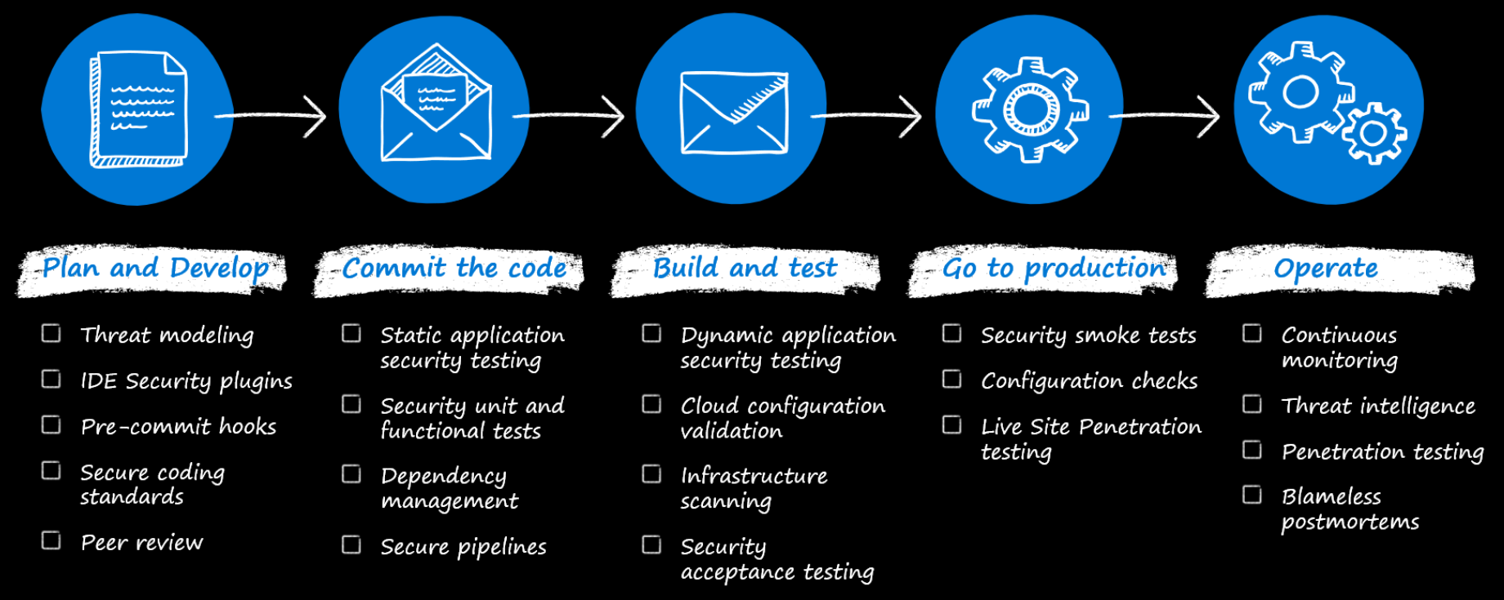
Bringing this all together

Slide 39
Takeaways
Start small, then grow!
Create cross-functional teams to avoid silos.
Involve security early!
Don’t reinvent the wheel.
Use tried and tested tools, and embed into your existing workflows as much as you can.

Slide 40



Thanks for listening!
@willvelida

